Slide 1
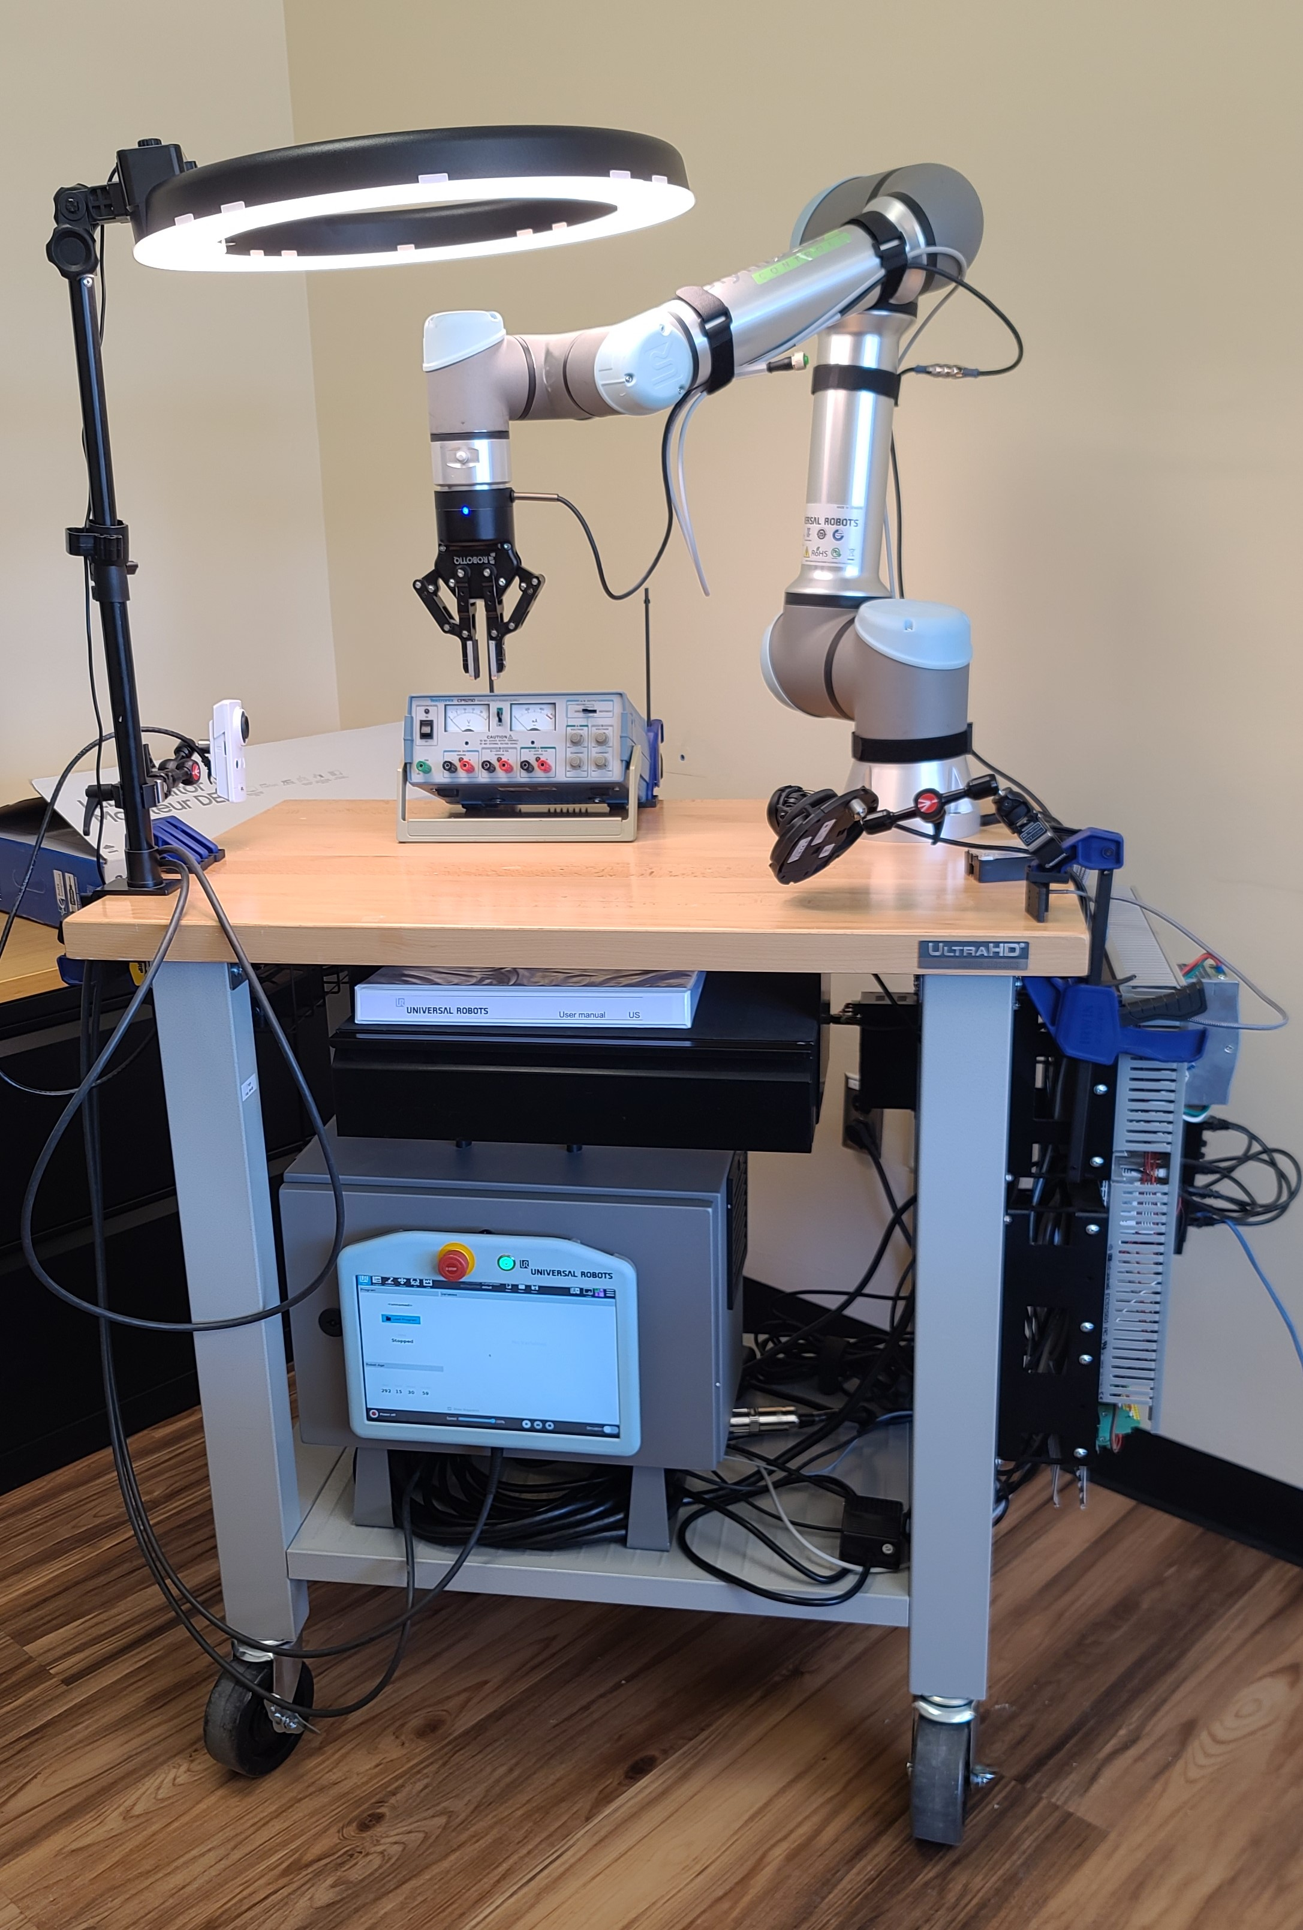

CSC485B Machine Learning for Robotics
SUNY Plattsburgh
Dr. Ned Lecky
Class 05- Getting Started with UR Programming

Slide 2
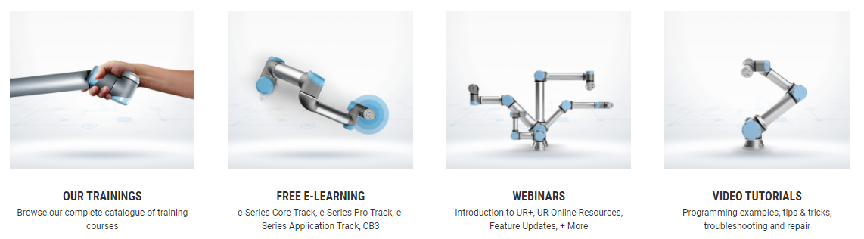
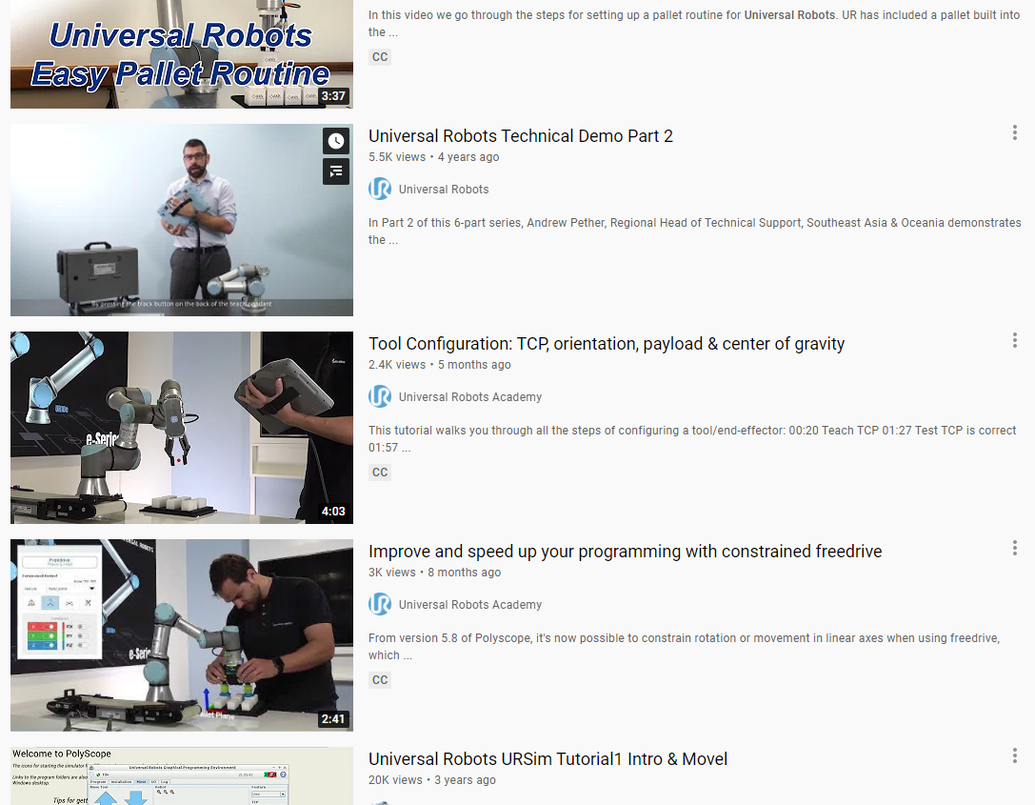
Some Definitive Resources
UR Academy: Comprehensive
academy.universal-robots.com
YouTube: Hands-on
www.youtube.com/results?search_query=universal+robots+programming

Slide 3



My Setup
Universal Robot UR-5e
Teach Pendant
All Robotics projects require some networking
UR Controller
Joint Controllers
120VAC Power
Ethernet Switch
My Laptop
VNC to Teach Pendant
Display Security Cams
Share to your screen!
Security Cameras
PoE Ethernet Switch

Slide 4
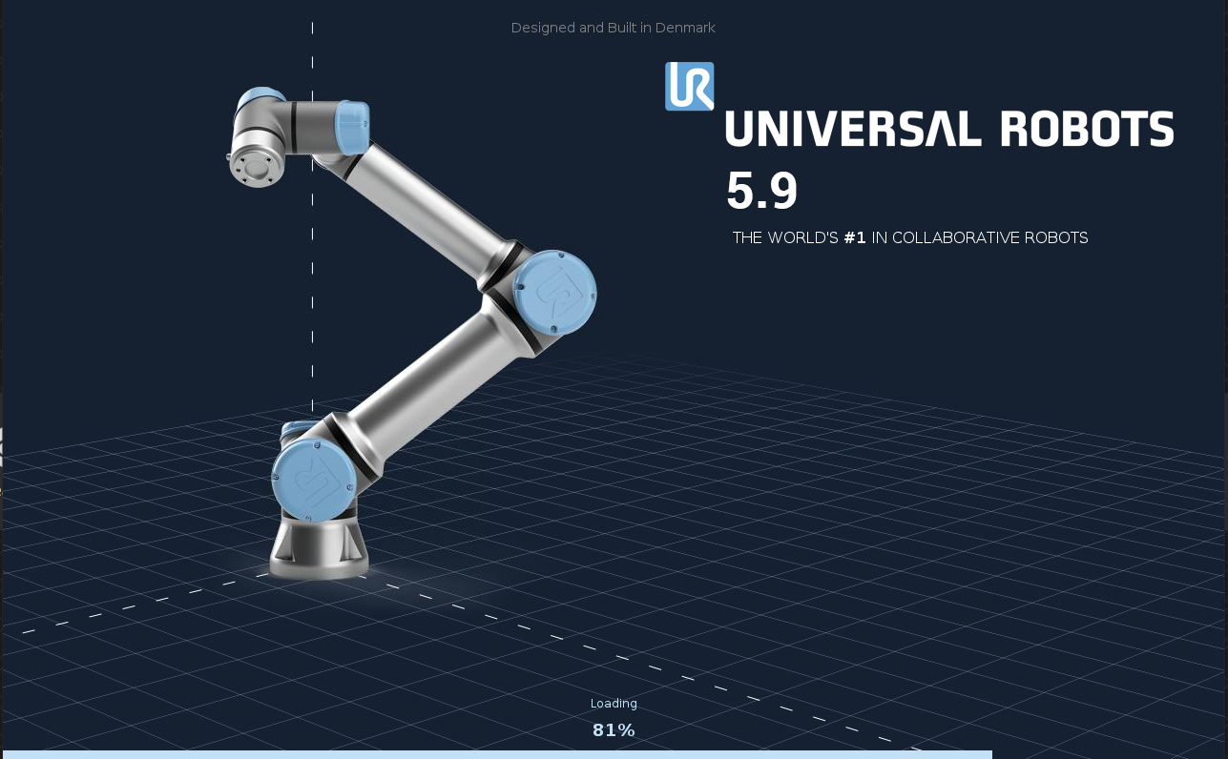
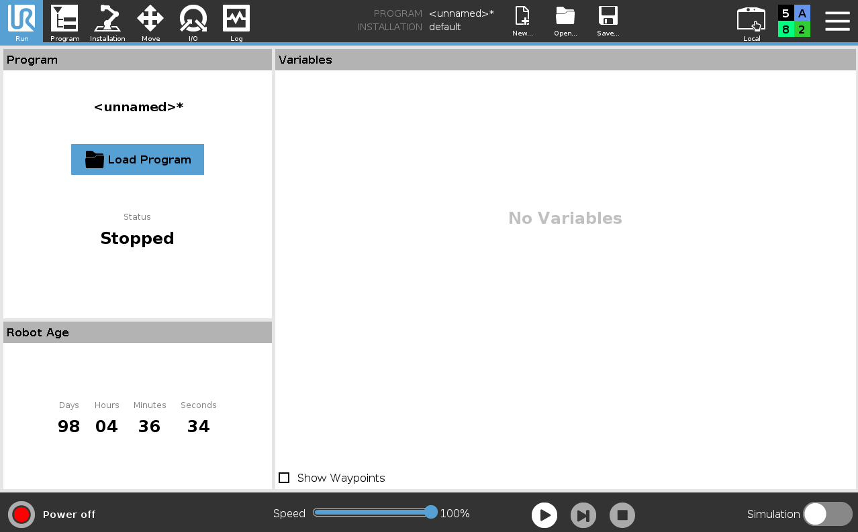
Getting Started in 5 Minutes
Hardware: plug 3 things into the controller box
Robot cable
Teach pendant cable
Power cord
Power On
Press the silver button next to the E-Stop on the teach pendant
Release E-stop by twisting it until it pops out
System boots for a few minutes to here
Power off
Press the silver button again while powered up
You’ll get power off, restart, cancel options

Slide 5
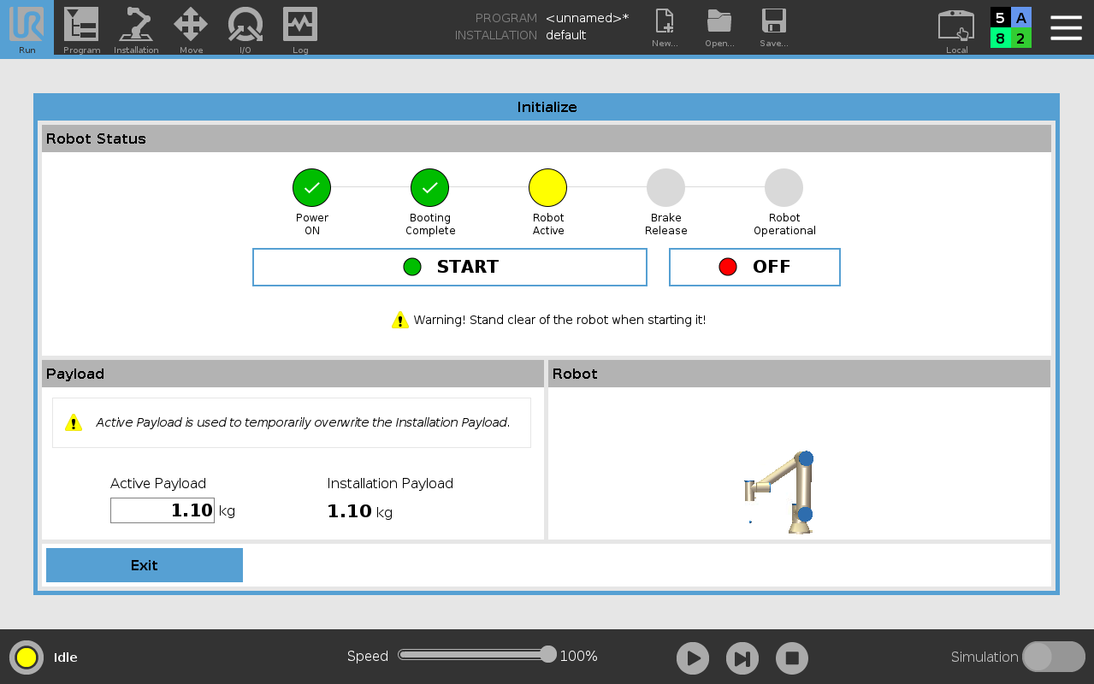
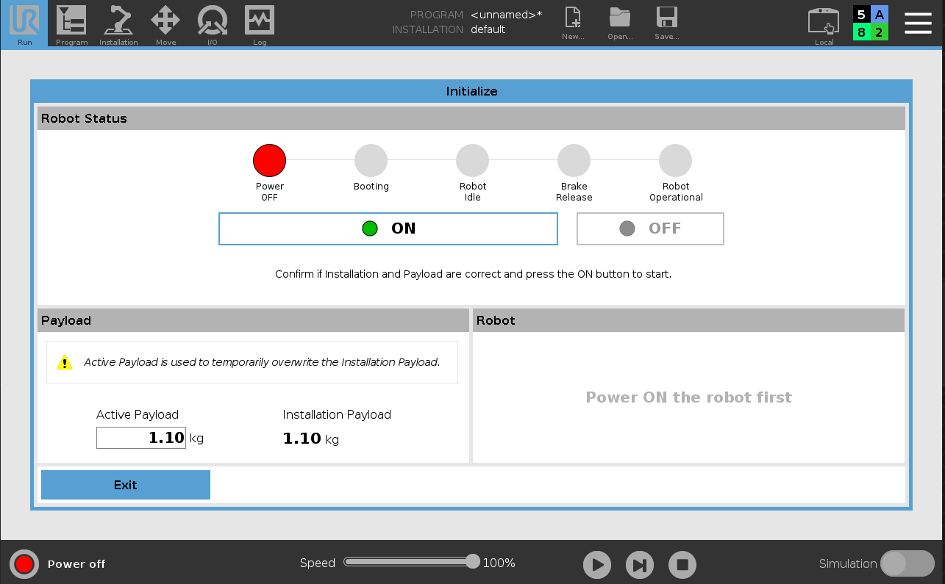
Enable the Robot
Release E-stop by twisting until it pops out
Click the Red Circle at the bottom left
Click ON
Click START
Brakes release and you’re on!
1
3
2

Slide 6
Main Options at The Top
Run: Only allow existing programs to be loaded and used
Program: Create and modify programs
Installation: Setup features in the robot world
Move: Jog the robot around manually
I/O: Turn on and off digital/analog/serial/packet input/output
Log: View robot operation logs
Try second!
Start here!

Slide 7
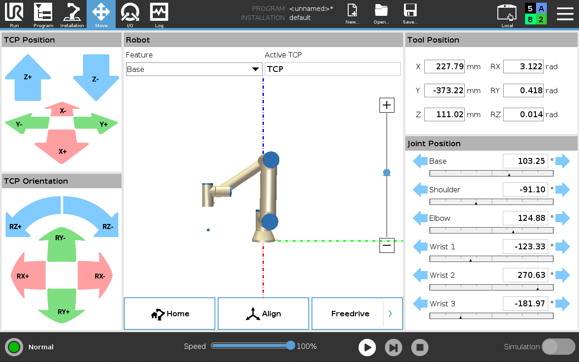
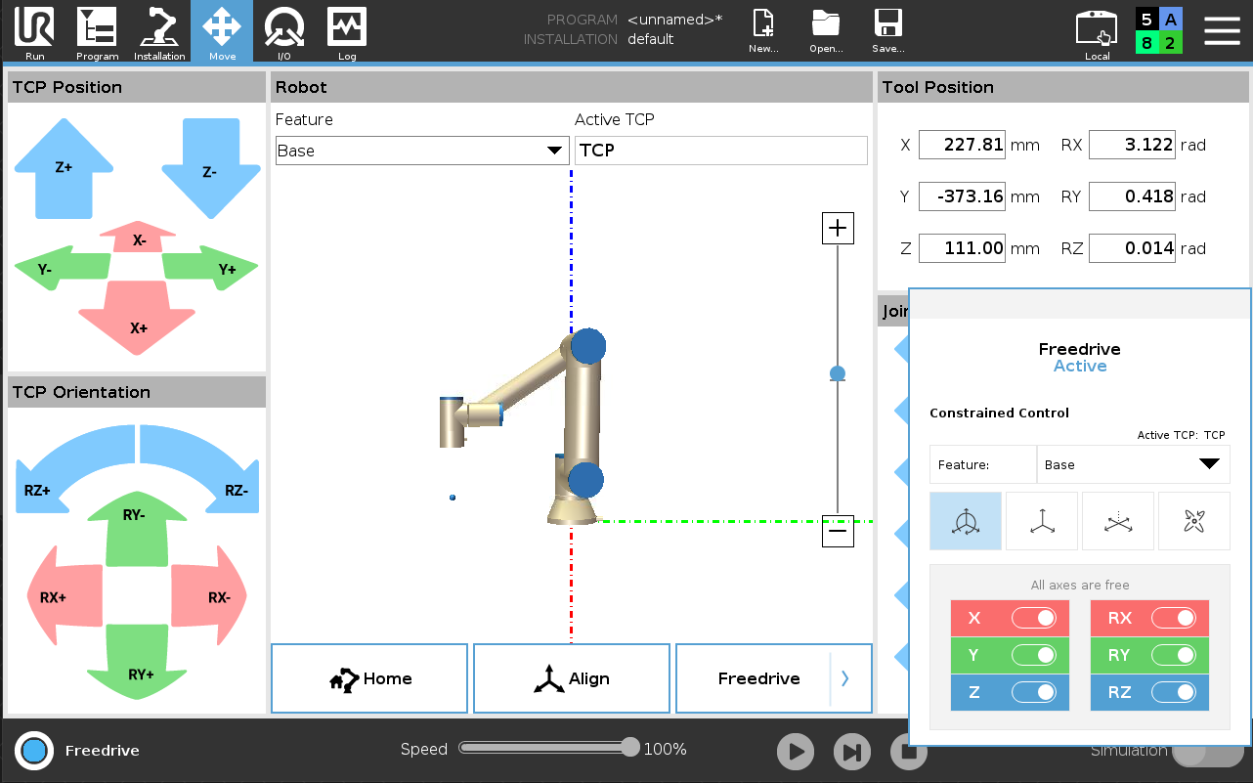
Jogging
TCP Position/Orientation
Tool Center Point (TCP)
Try it in Feature: Base, Tool, and View
(Move the view around to see the effect in View!)
Joint Position
Moves one joint at a time
Freedrive
Push and hold the button on the back of the teach pendant
Can choose any set of axes to be free, in either base or tool coordinates

Slide 8
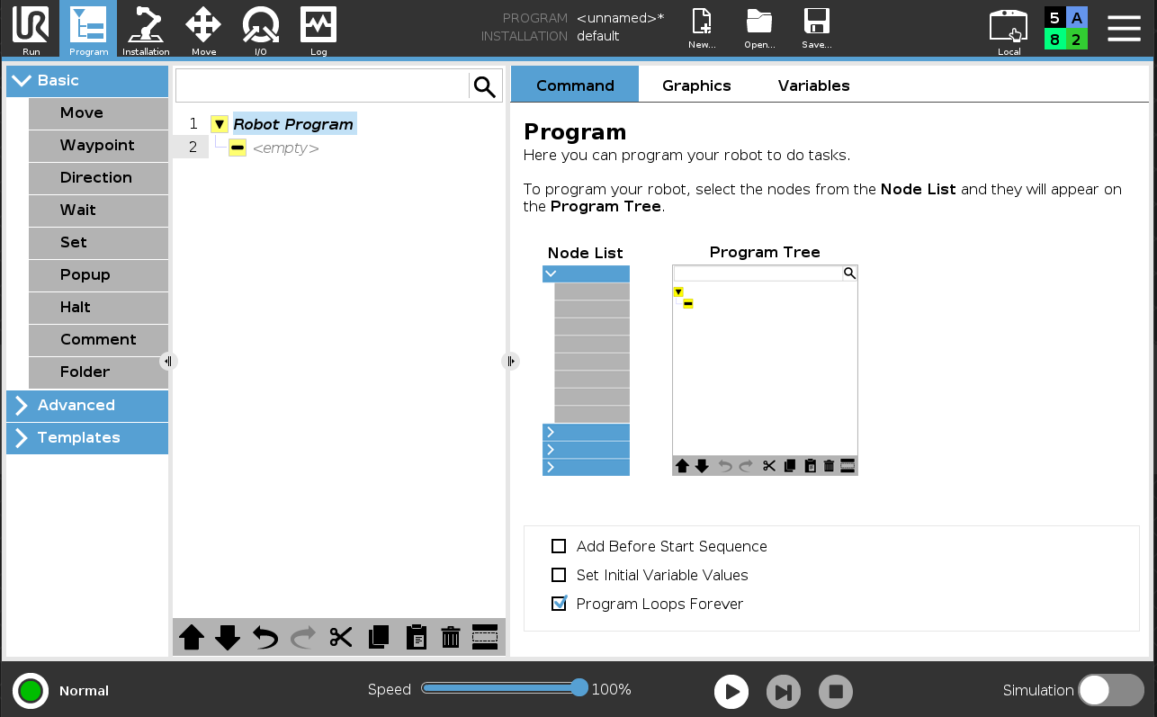
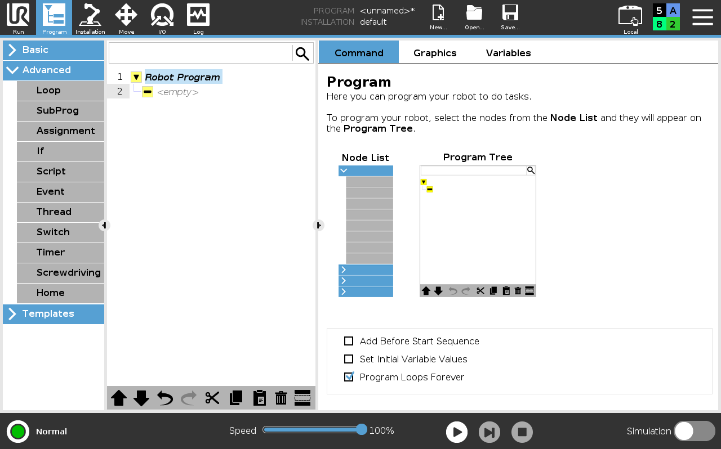
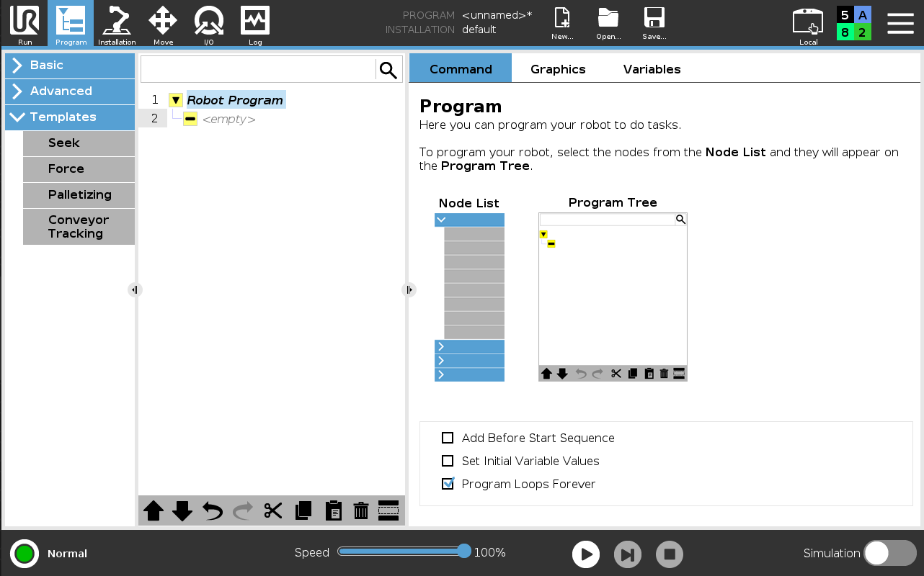
Programming
Three sets of primitives
Basic
Advanced
Templates
Optional 4th set
URCaps (3rd party add-ons)
Huge hardware and software ecosystem
www.universal-robots.com/plus/products/?

Slide 9
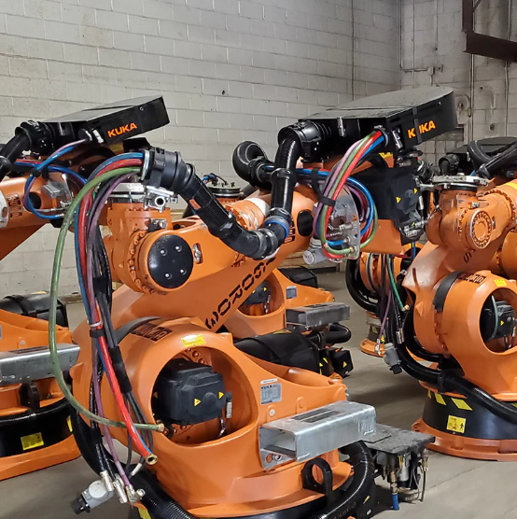
Things worth Demoing
Before we try an “application”
TCP
Payload/CG
Free Drive
MoveJ
MoveL
Direction Until
URCap
IO Control- look in the cabinet@
About Robot Kinematics in Jog…
We’re using a UR here but you’d find all of these features and a fairly similar programming process for Fanuc, ABB, Kawasaki, Kuka, etc. etc. etc.
And always remember your Dress Pack!
85% of all robot failures

Slide 10
A First Program
Live Demo with the power supply!
Videos
COMING SOON-ISH
So don’t forget UR Academy and YouTube!!

